Slide 1
Applications of Information & Communication Technology
Mr. Ali Haider
Institute Of Management Sciences

Slide 2
Basic Computer Components
Computer Case
Input Units
Mouse, Keyboard
Joystick, Screen
Output Units
Screen
Printer

Slide 3
Internal Components of Computer
Motherboard
Central Processing Unit
Random Access Memory
HDD, SSD, SSHD (Solid State Hybrid Drives)
Power Supply

Slide 4
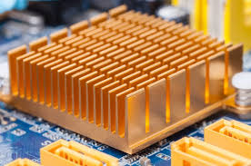
Video Card (GPU)
Network Card
Bluetooth Card
Cooling Fan
Heatsink
BIOS (Firmware)

Slide 5
Details
https://openbookproject.net/courses/intro2ict/hardware/internal.html

